Slide 1
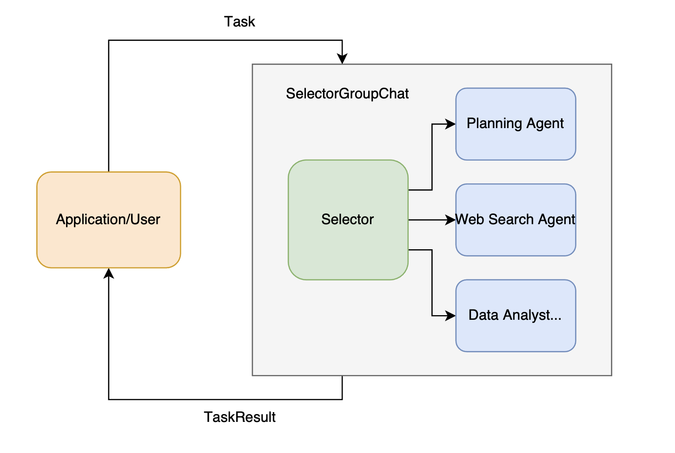
In
VLM
Out
Query/ Results
Read/
Write
Call/
Response
Retrieval
Memory
Tools

Slide 2
Agent
Task
Memory
Read/
Write
User/ Application
VLM
Call/Response
Tools
Query/ Results
Retrieval
Task Results

Slide 3
Agent
Task
Memory
Read/
Write
User/ Application
AI model
Call/Response
Tools
Query/ Results
Retrieval
Task Results

Slide 5


Teacher
Model
Data
Loss
Student
Model

Slide 6
Teacher
Model
Knowledge transfer
Student
Model

Slide 7
In
AI model
Out
Query/ Results
Read/
Write
Call/
Response
Retrieval
Memory
Tools

